Slide 1


Slide 2
Web Based
BIM Authoring Tool
Presented By:
Fouad Mostafa
Mohamed Mahmoud

Slide 3
Agenda
Problem definition
Our solution
Product Vision
Development Scenarios & Tools
Business Model
Demo
Conclusion
Future work

Slide 4
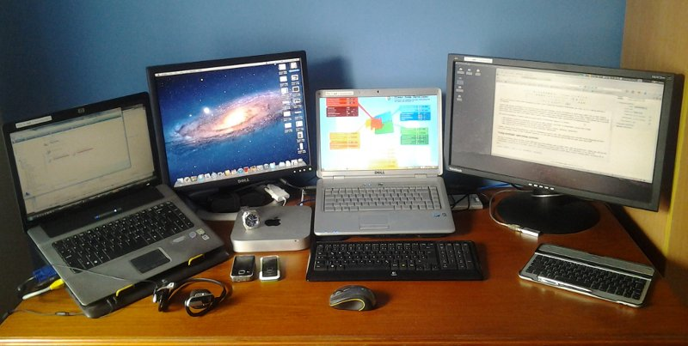
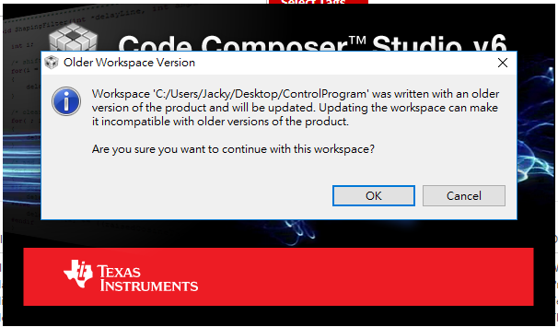
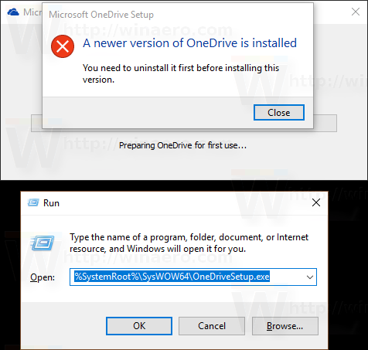
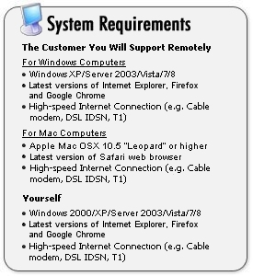
Problem Definition
One person needs to use more than one device
Same Product ,but many versions
Installation Headache
System Requirements

Slide 5



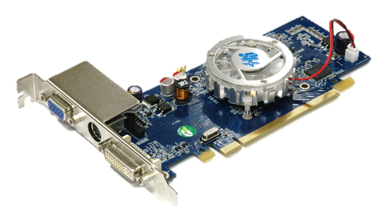
Our Solution
Access From Any Device
Application Always Updated
No Installation Needed
Only Reasonable Graphics Card is Required

Slide 6





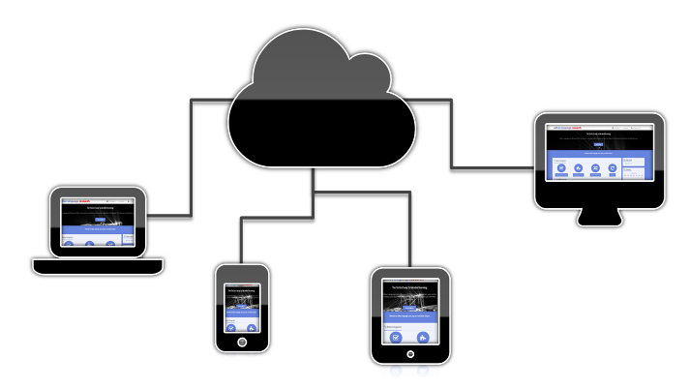
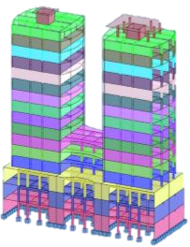
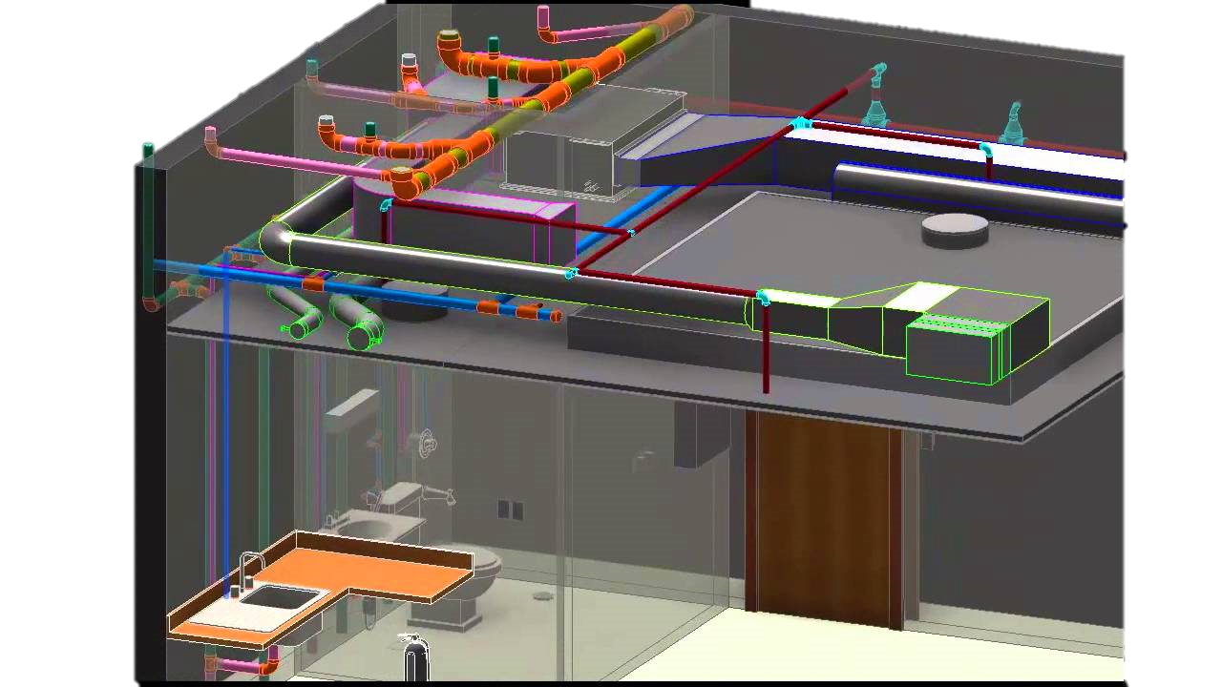
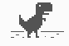
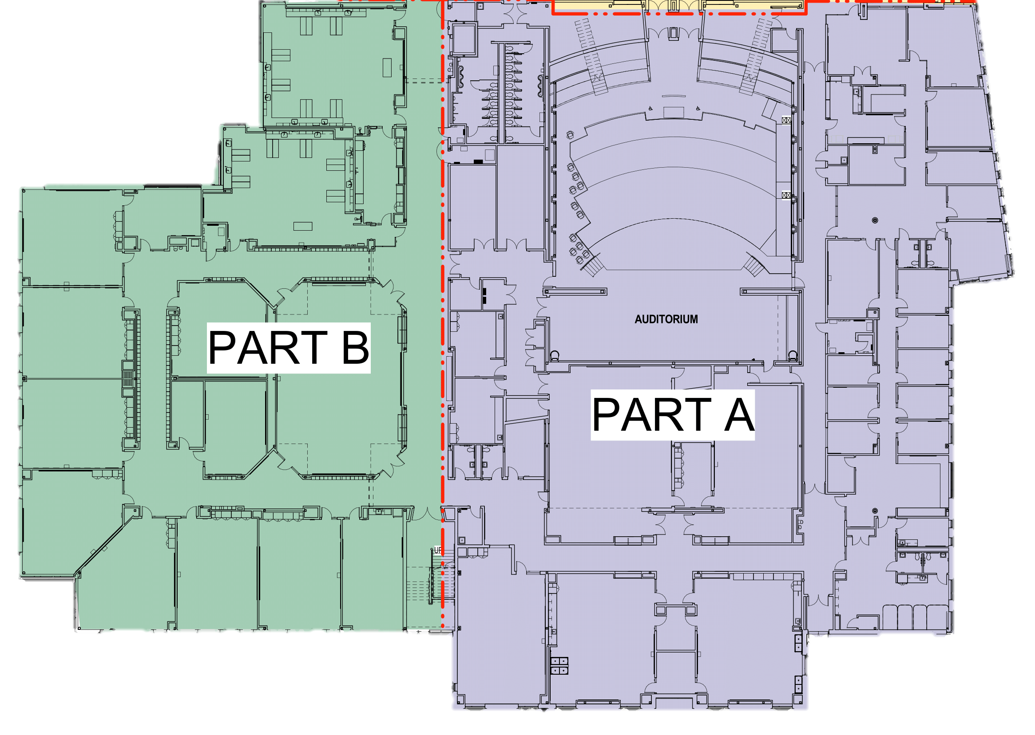
Product Vision
Access from any device
Architectural , MEP Modeling
Structural Modeling , Analysis and Design
Data Backup for Internet failure
Model Blocks

Slide 7
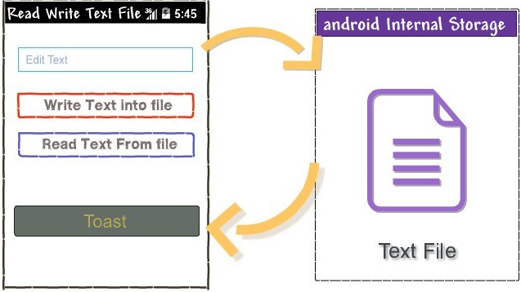
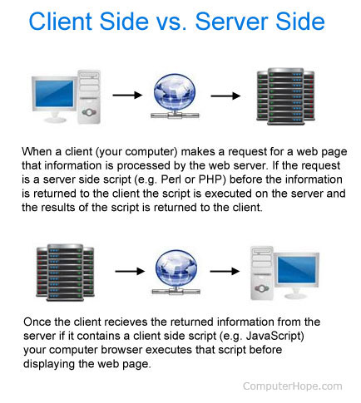
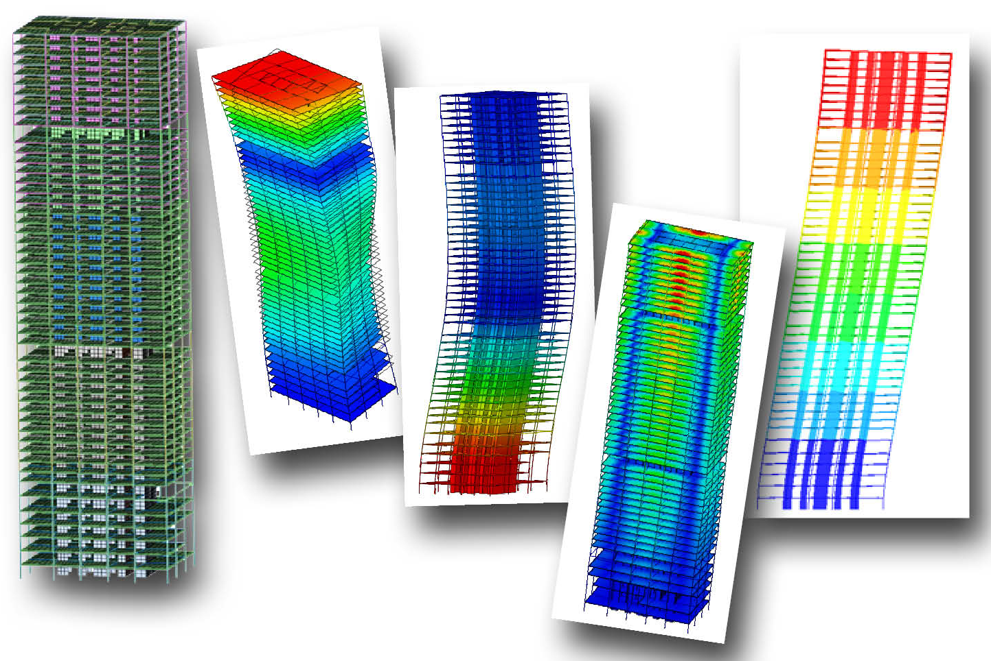
Development Scenarios and tools
Read / Write IFC files
Perform Structural Analysis
Send/Receive Model Data To/From Website
Tools to use

Slide 8
BIMgo Classes
IFC file
Sap API
Sap API Helper
BIMgo Adapter
IFC Helper
Xbim
IFC file
BIMgo Website
BIMgo API
ASP. Net Core MVC
ASP. Net framework
BIMgo UI
Three.js , Bootstrap

Slide 9




Business Model
Target Segment : All AEC Domain partners
Added Value : Multiple Devices , Auto Update , No installation And low System Requirements
Promotion : Sample Demos , Tutorial Videos , Free Trials

Slide 10
Demos
Hope you Enjoy Watching our Demos …..

Slide 11



Conclusion
Data Optimization method used in creating small file size is working good
BIMgo classes schema are successful and extendable
Storage using IFC files needs new standards or using proxy will be the workaround
Some logic needs to be implemented to make up for missing data

Slide 12
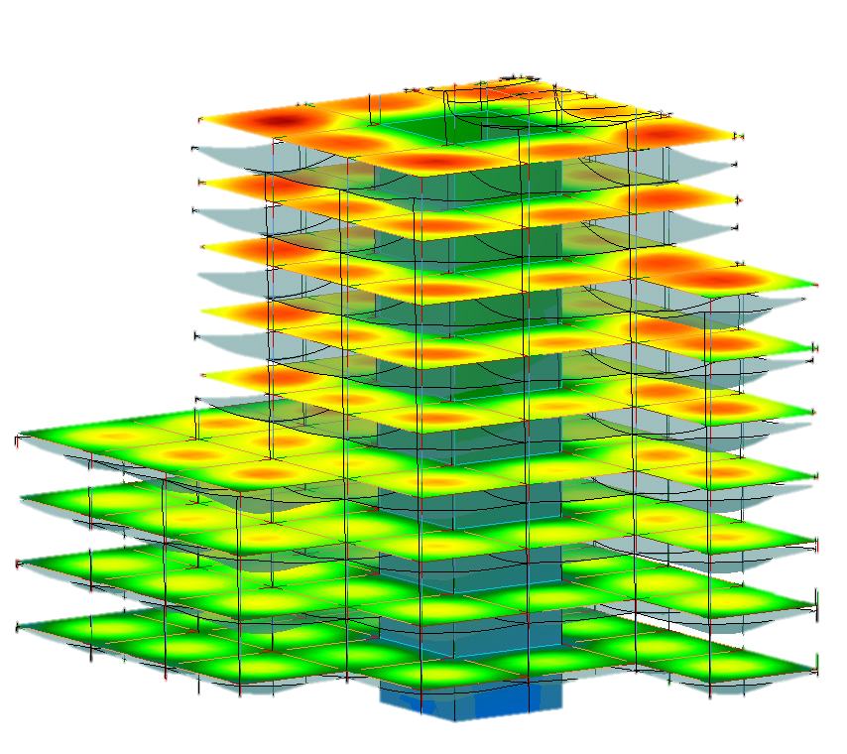
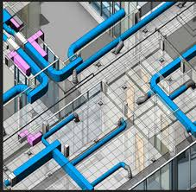
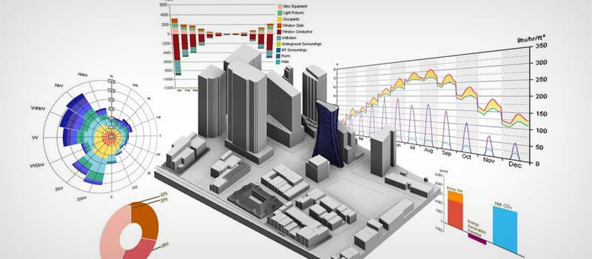


Future Work
Analysis and Design Libraries
Complete Architectural and Structural modeling Features
Adding MEP Modeling
Management features
VR applications
AR applications

Slide 13
Thanks ……..

